Slide 1
From “Where” to “What”: Towards Human-Understandable Explanations through Concept Relevance Propagation^{[1]}
MI2 DataLab Summer Research Seminar 2023
^{[1]}Achtibat, Reduan, Dreyer, Maximilian, Eisenbraun, Ilona, Bosse, Sebastian, Wiegand, Thomas, Samek, Wojciech, and Sebastian Lapuschkin. "From "Where" to "What": Towards Human-Understandable Explanations through Concept Relevance Propagation."

Slide 2
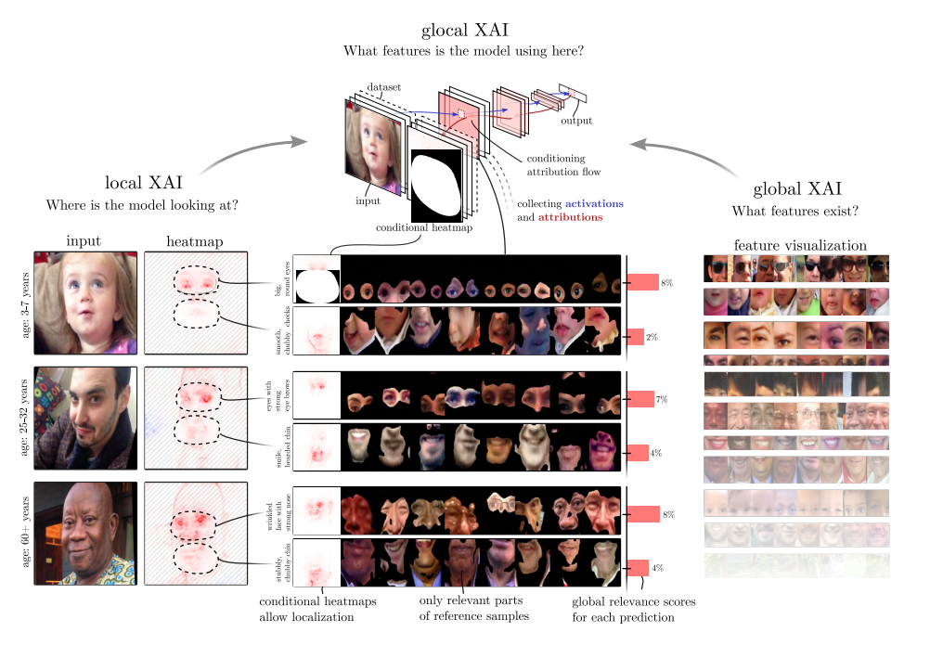
Global vs Local XAI

Slide 3
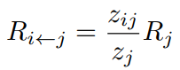
LRP – backbone of CRP
Layer-wise Relevance Propagation (LRP) uses hierarchical structure of neural networks to calculate „relevance” of each input. Relevance of layer i with respect to layer j is calculated using relevance of layer j and activations.

Slide 4
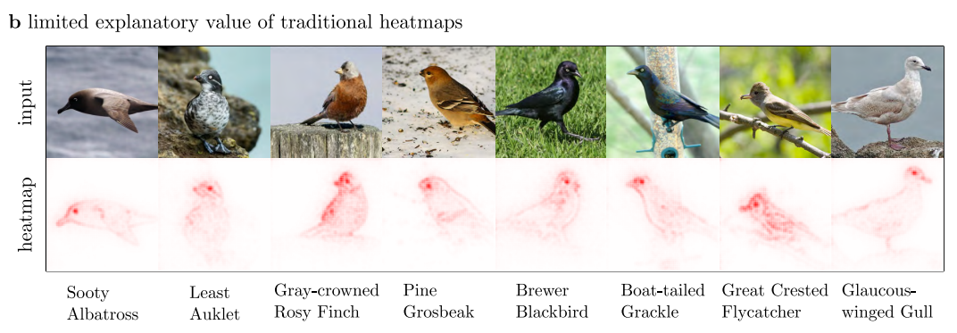
Limitation of traditional heatmaps

Slide 5
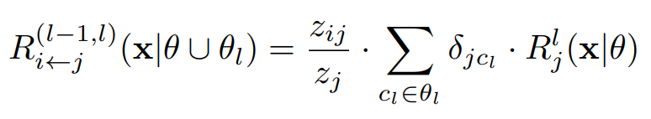
Concept Relevance Propagation
CRP uses same concept as LRP but adds „filtering” based on filters which are model parameters.

Slide 6
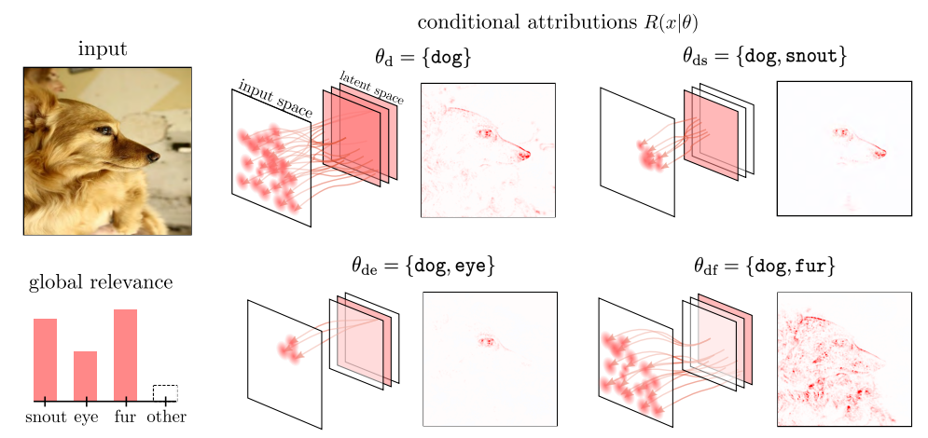
Explanation disentanglement via Concept Relevance Propagation

Slide 7
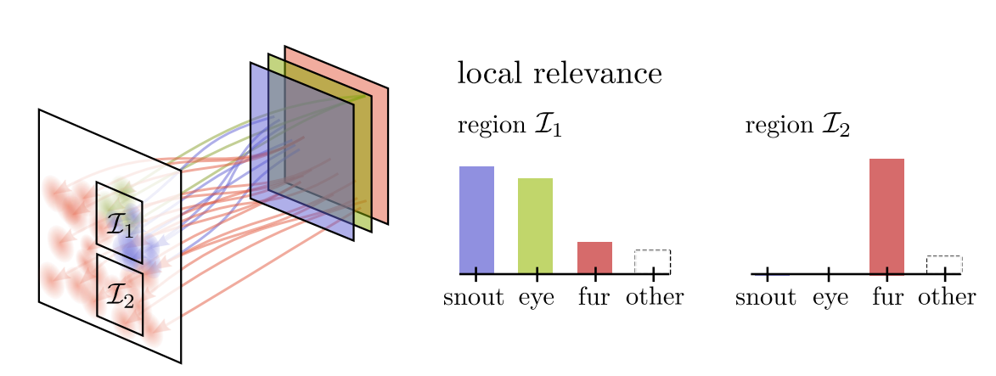
Local Concept Relevance

Slide 8
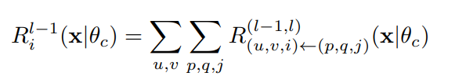
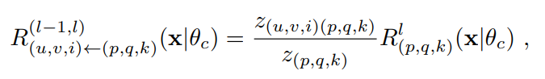
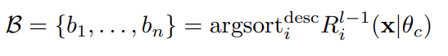
Hierarchical Composition of Relevant Concepts
Having some concept c at layer l we can decompose it into concept in lower layers using relevance propagation.
After calculating conditional relevance of concepts of lower layers we can sort them to get decomposition of our concept c

Slide 9
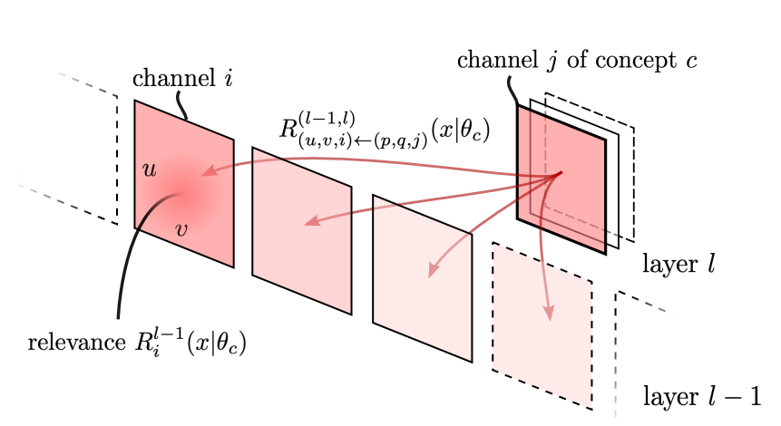
Hierarchical Composition of Relevant Concepts

Slide 10
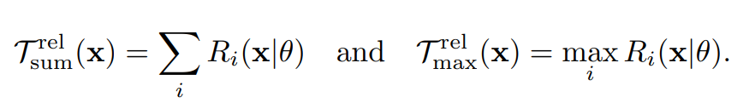
Relevance-based Reference Sample Selection
Instead of selecting samples from dataset based on „Activation maximization” authors propose selection of „concept” samples maximizing relevance (how useful was concept for the output). They propose usage of two maximization targets

Slide 11
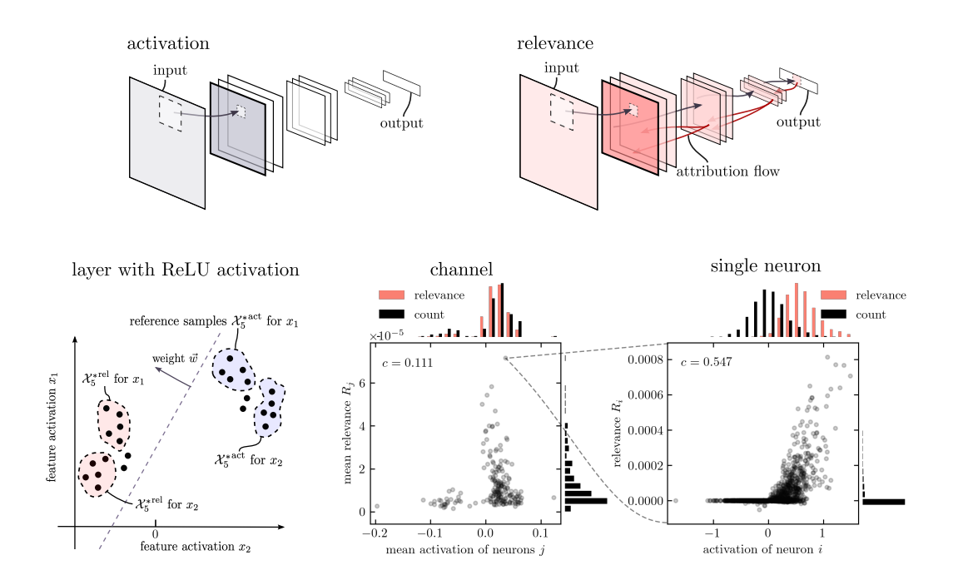
Activation vs Relevance Maximization

Slide 12
Receptive field
To be able to zoom into samples authors propose receptive field of j neuron at layer l given by:
Condition on θ ensures initialization of LRP with δ_{kj} at layer l’

Slide 13
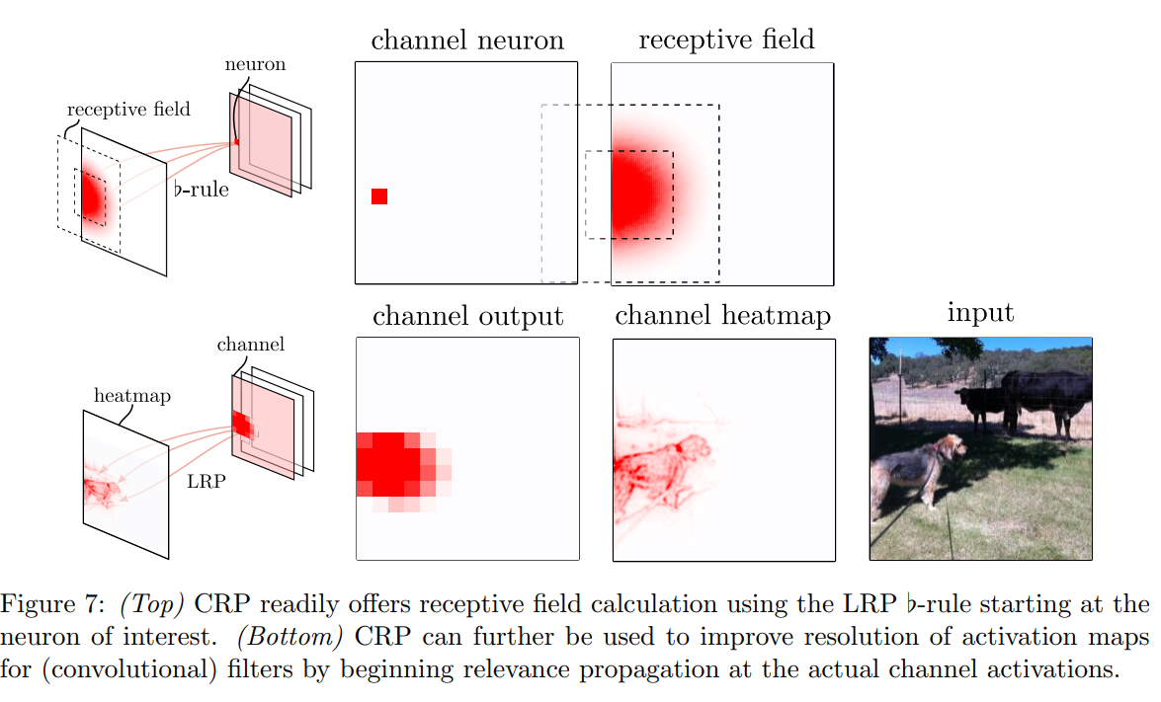
Zooming into the Reference Sample

Slide 14
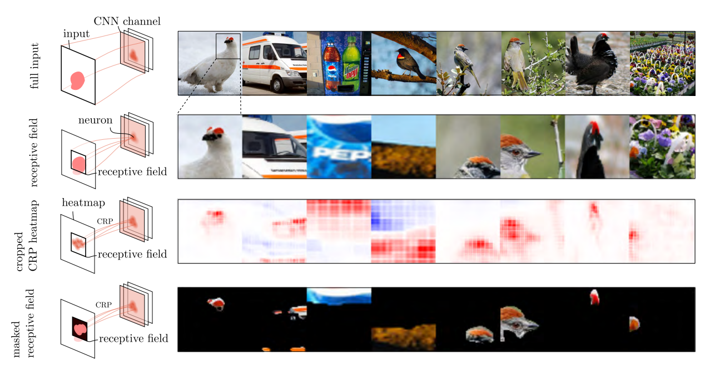
Concept visualization using CRP

Slide 15
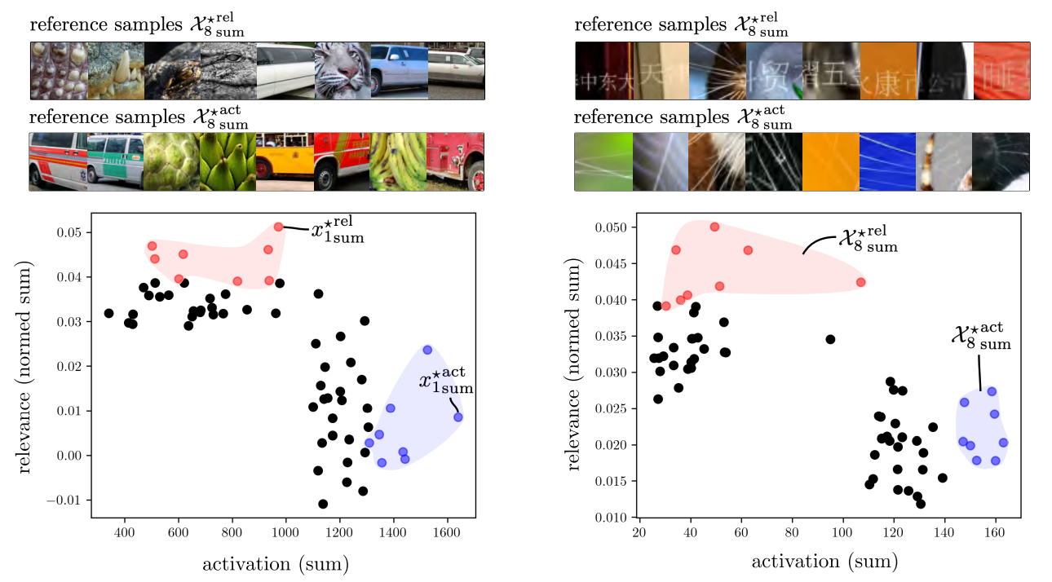
Activation- vs Relevance-based Sample Selection

Slide 16
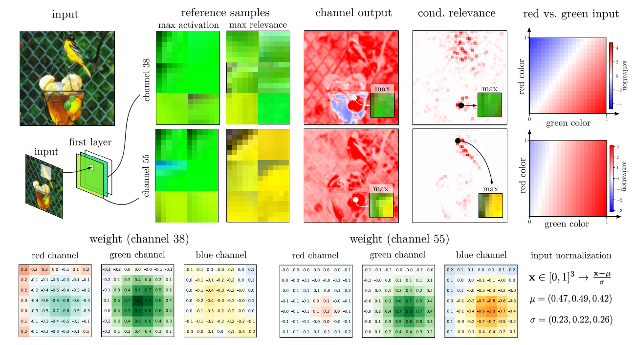
Lower-level concepts

Slide 17
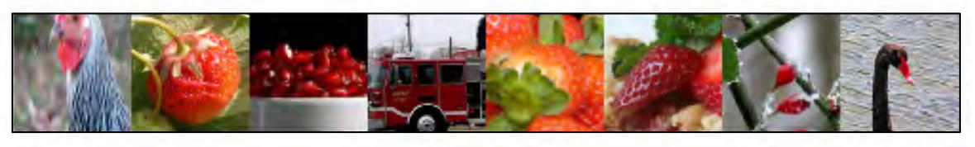
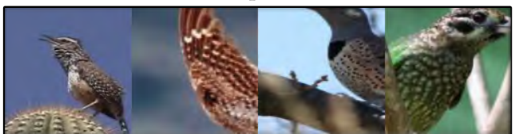
Handling High and Low Sample Set Variety
High Variety
Low Variety

Slide 18
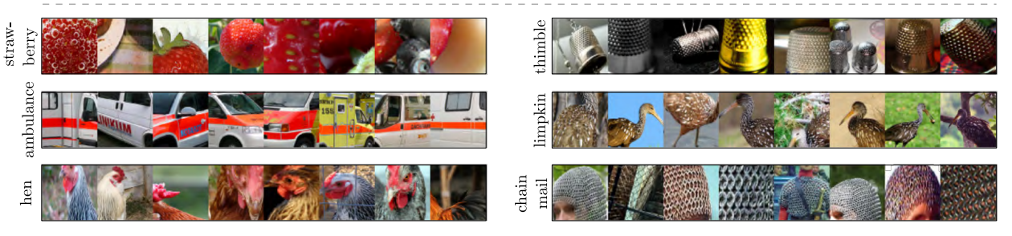
Class-Conditional Reference Sample Selection

Slide 19
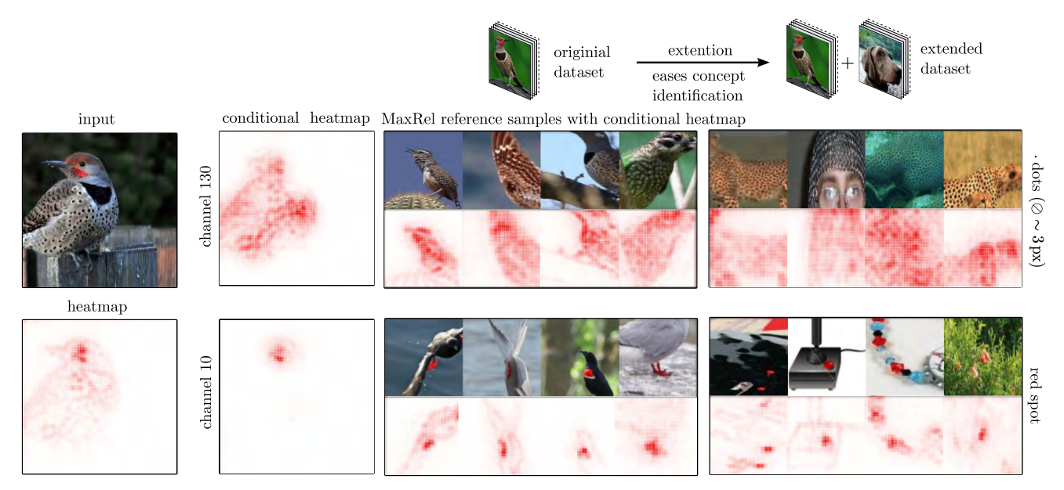
Reference Dataset Extension

Slide 20
Concept Atlas and Understanding Spatial Concept Composition
Creation of „Atlas” is done in two steps.
Generating superpixels of image.
Selecting concept with highest relevance to all superpixels

Slide 21
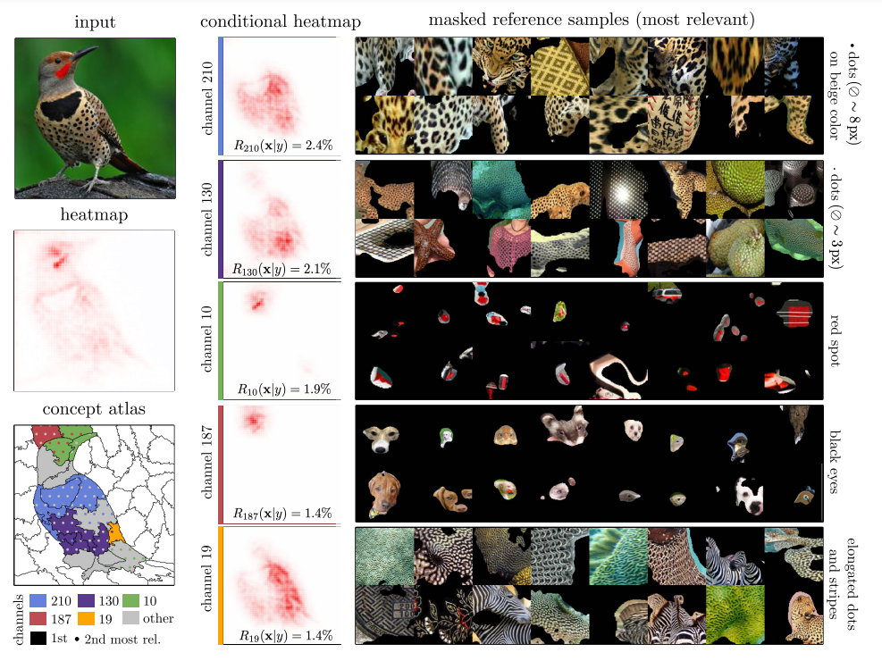

Slide 22
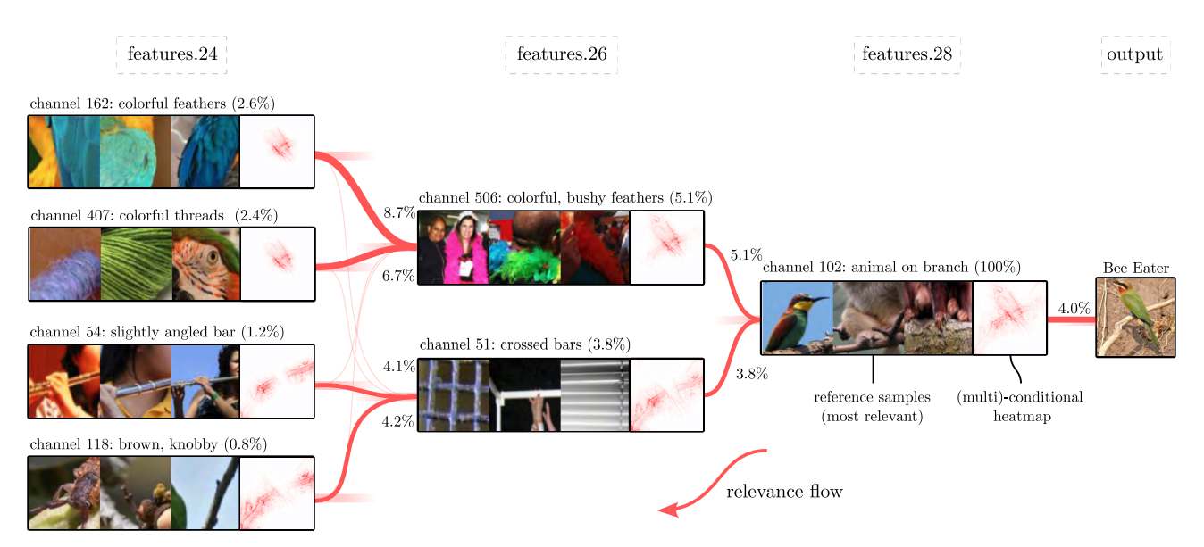
Hierarchical Concept Composition example

Slide 23
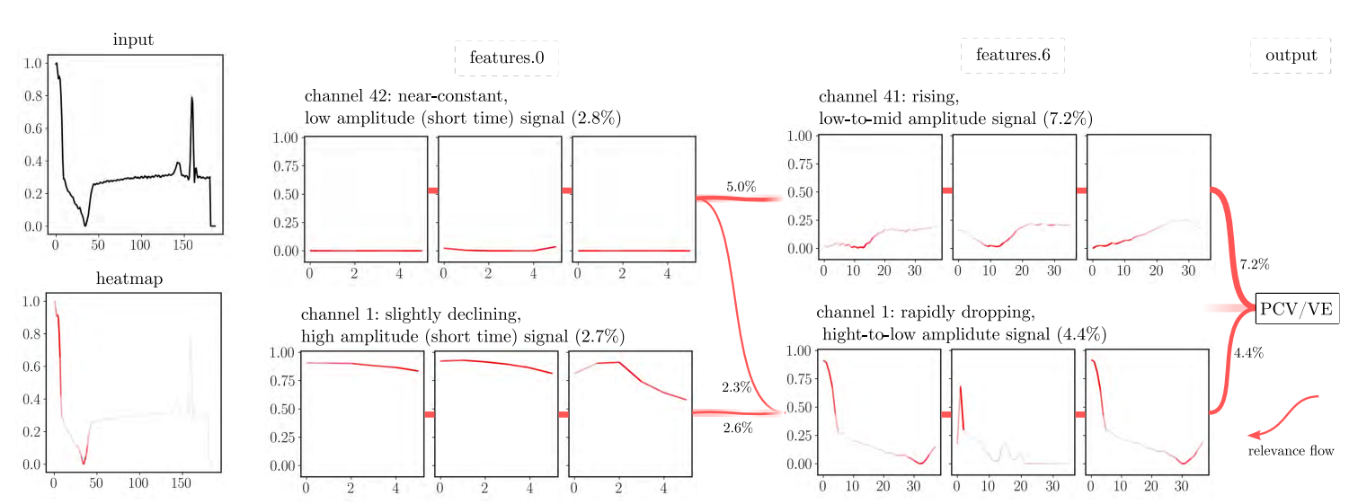
Time series concepts

Slide 24
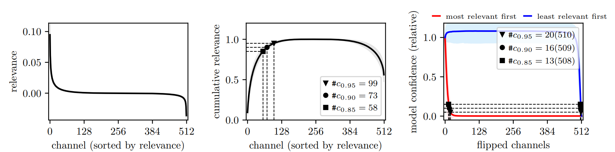
Quantifying the Foundation of Decision Making

Slide 25
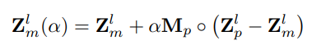
Inserting concept into model prediction
Authors introduce way to „insert” concepts into prediction to check how they affect model.
They propose to replace activation of input without concept with activation of input with concept.
Where α controls degree of blending concept into prediction. While training model on ISIC dataset they found that it learned concept related to „band-aid”

Slide 26
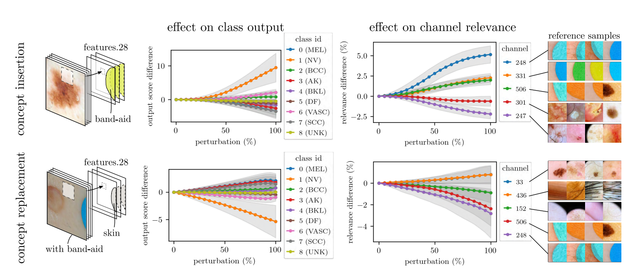

Slide 27
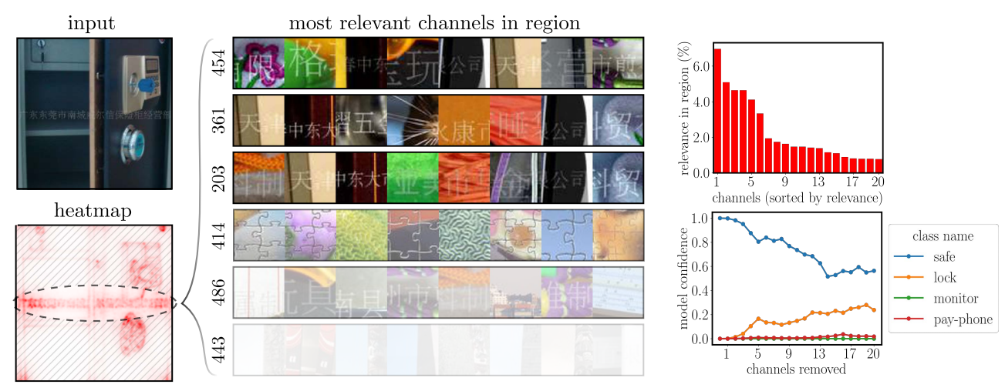
ImageNet analysis using CRP

Slide 28
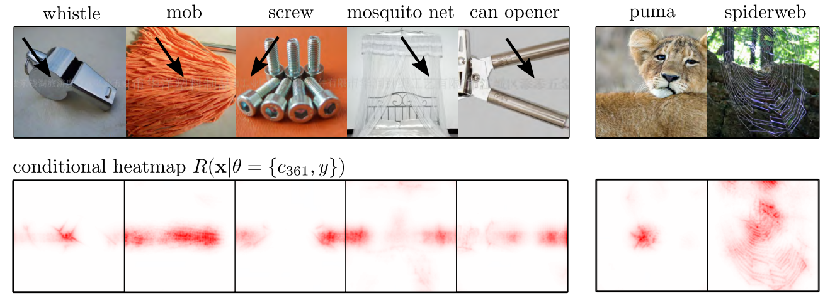
ImageNet analysis using CRP

Slide 29
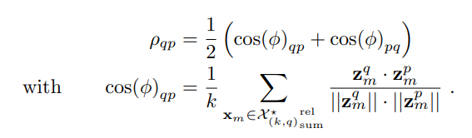
Concept Similarity in Latent Space
Authors propose way to calculate similarity between channels p and q in layer:

Slide 30
Thank you for your attention

